Slide 1
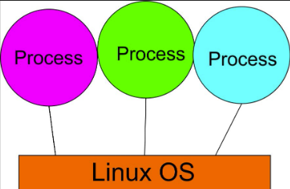
Operating System UNIT 1
Process Management
By
Amandeep Kaur

Slide 2
Topics
Process Control Block (PCB)
Operations on Processes
Types of Process (Co-operating and Independent Processes)
Process States/Life Cycle of Process
Process Concept

Slide 3
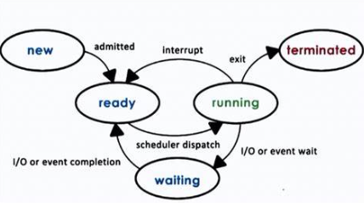
Process Concept
Process: A process is a program in execution, consisting of program code, data, and resources.
An active program or active entity means process is under execution in processor (CPU).
The execution of a process must progress in sequential order or based on some priority or algorithms.

Slide 4
What is process?
A) A process is a hardware component that handles memory allocation.
B) A process is a static file stored on disk that cannot change during execution.
C) A process is a program in execution, consisting of program code, data, and resources.
D) A process is a network protocol used for data transmission between computers.

Slide 5
Ans. C
C) A process is a program in execution, consisting of program code, data, and resources.

Slide 6
Process Control Block (PCB)
To maintain information about the process state, process ID, program counter, and registers.
It is a data structure maintained by the OS for every process and identified by process ID (PID) to keep track of a process as listed below in the table −
Process State
The current state of the process i.e., whether it is ready, running, waiting, or whatever.
Process privileges
This is required to allow/disallow access to system resources.
Process ID
Unique identification for each of the process in the operating system.
Pointer
A pointer to parent process.
Program Counter
Program Counter is a pointer to the address of the next instruction to be executed for this process.
CPU registers
Various CPU registers where process need to be stored for execution for running state.

Slide 7
PCB
CPU Scheduling Information
Process priority and other scheduling information which is required to schedule the process.
Memory management information
This includes the information of page table, memory limits, Segment table depending on memory used by the operating system.
Accounting information
This includes the amount of CPU used for process execution, time limits, execution ID etc.
IO status information
This includes a list of I/O devices allocated to the process.

Slide 8
What is the purpose of the Process Control Block (PCB) in an operating system?
A. To control the input/output operations.
B. To store the code of the process.
C. To maintain information about the process state, process ID, program counter, and registers.
D. To handle the network protocols.

Slide 9
Ans: C
C) To maintain information about the process state, process ID, program counter, and registers.

Slide 10
The address of the next instruction to be executed by the current process is provided by the __________
a) CPU registers b) Program counter c) Process stack d) Pipe

Slide 11
Ans: b
The address of the next instruction to be executed by the current process is provided by the Program Counter. After every instruction is executed, the Program Counter is incremented by 1 i.e. address of the next instruction to be executed. CPU fetches instruction from the address denoted by Program Counter and execute it.

Slide 12
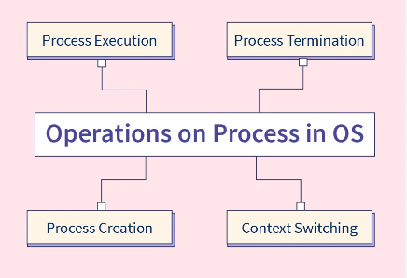
Operations on Process
Process Creation: fork()
Process execution (CPU Scheduling)
Context Switching (Swap process in Pre-emptive case)
Process Termination or Deletion: exit() or kill()

Slide 13
Operations on Process
Process Creation:
The OS can create a new process, which involves allocating necessary resources, initializing process control blocks, and assigning a unique process ID. A new process is usually created by another process, called the parent process, and the newly created process is known as the child process.
Process Termination:
The OS can terminate a process, which involves deallocating resources, removing the process control block, and notifying the parent process. Termination can happen normally (when a process completes its execution) or abnormally (due to errors or external intervention).
Process Scheduling:
The OS decides which process should be executed by the CPU at any given time. This is known as process scheduling. The OS uses various algorithms (like Round Robin, First-Come-First-Served) to determine the order of process execution.

Slide 14
Operations on Process
Process Synchronization:
When multiple processes need to work together or share resources, the OS must ensure that these processes are synchronized to avoid conflicts or data inconsistencies. This often involves mechanisms like semaphores or monitors to manage access to shared resources.
Process Communication:
Processes may need to communicate with each other, either within the same system or across different systems. The OS provides mechanisms for Inter-Process Communication (IPC), such as message passing, shared memory, or sockets.
These operations are essential for the efficient management of processes, ensuring that the system runs smoothly and resources are allocated effectively.

Slide 15
Which of the following is an operation that can be performed on a process in an operating system?
A) Decrypting a process to increase security.
B) Deleting a process's source code from memory.
C) Terminating a process to free up system resources.
D) Compiling a process directly within the CPU.

Slide 16
Ans: C
C) Terminating a process to free up system resources.

Slide 17
What is context switching?
A. Switching between user mode and kernel mode.
B. Switching between multiple programs in the background.
C. Saving the state of a process and loading the state of another process.
D. Switching between different memory spaces.

Slide 18
Ans: C
C. Saving the state of a process and loading the state of another process.

Slide 19
Co-Operating VS Independent Process
S.NO. | CO-OPERATING PROCESS | INDEPENDENT PROCESS
1. | I/O Bound | CPU Bound
2. | I/O bound: is a time in which a process perform input output operation. e.g take input from keyboard or display output in monitor. | CPU bound: is a time process reside in processor and perform it's execution.
3. | Also known as Dependent/concurrent process. | Also known as isolated/competing process.
4. | Dependent:in it process can share some deliver buffer variable ,resources,(cpu,printer). it process can share any thing, then execution of one process can effect other. ->execution of one process can effect or get affected by the execution of process. | Execution of one process does not effect the execution's of other process that means there is nothing common for sharing.

Slide 20
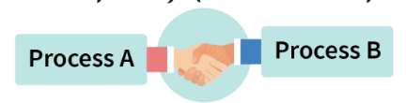
IPC (Inter-Process Communication)
IPC refers to the mechanisms and techniques that operating systems use to facilitate communication between different processes.
In a multitasking environment, numerous processes are running concurrently, and IPC serves as the bridge that allows them to exchange information and coordinate their actions.

Slide 21
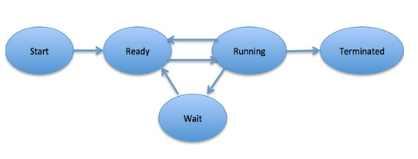
Process States or Life Cycle of Process
Process State: As a process executes, it changes state. The state of a process is defined in part by the current activity of that process. Each process may be in one of the following states:
It includes five stages of process which is also known as Life Cycle of process.
New: In this state, the process is being created.
Running: In this state, instructions are being executed.
Waiting: In this state, the process is waiting for different events like I/O completion or treatment of a signal.
Ready: In this state, the process waits to assign a processor.
Terminated: In this state, the process has finished executing.

Slide 22
Which of the following is NOT a valid process state?
A. New
B. Running
C. Waiting
D. Deleting or Terminated
E. Scheduled

Slide 23
Ans: E.
E. Scheduled

Slide 24
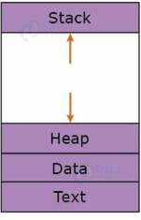
Process in OS
Process can be divided into four sections ─ stack, heap, text and data. The following image shows a simplified layout of a process
Stack: The process Stack contains the temporary data such as method/function parameters, return address and local variables.
Heap: This is dynamically allocated memory to a process during its run time.
Data: This section contains the global and static variables.
Text: This includes the current activity represented by the value of Program Counter and the contents of the processor's registers.

Slide 25
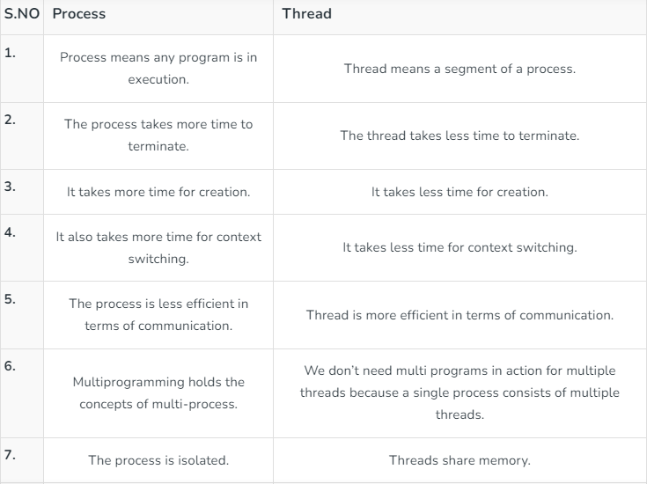
Process VS Thread

Slide 26
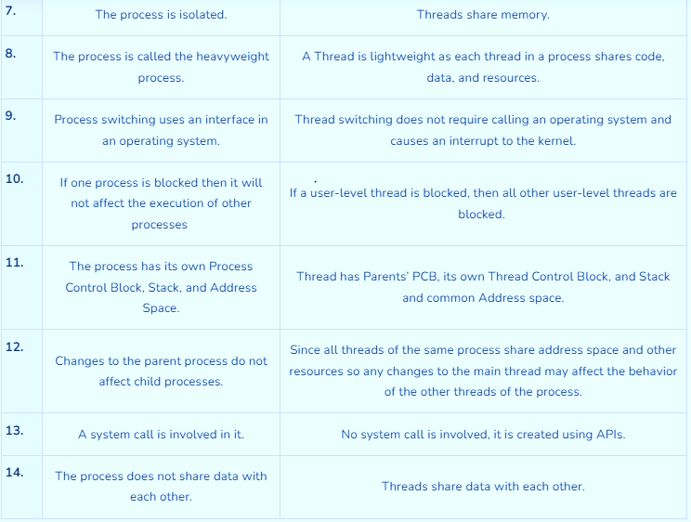
Process VS Thread

Slide 27
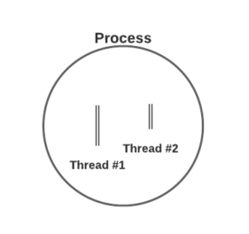
Process and Thread

Slide 28
What is a thread in an operating system?
A) A thread is a type of software that manages file systems.
B) A thread is the smallest unit of execution within a process.
C) A thread is a physical component of the CPU that processes instructions.
D) A thread is a network connection between two processes on different machines.

Slide 29
Ans: B
B) A thread is the smallest unit of execution within a process.

Slide 30
References
OPERATING SYSTEM CONCEPTS by ABRAHAM SILBERSCHATZ, PETER B. GALVIN, GERG GAGNE, WILEY
DESIGN OF THE UNIX OPERATING SYSTEM by MAURICE J. BACH, Pearson Education India
REAL-TIME SYSTEMS by JANE W. S. LIU, Pearson Education India
https://www.javatpoint.com/process-vs-thread
https://www.geeksforgeeks.org/difference-between-process-and-thread/
https://www.javatpoint.com/os-process-states

Slide 31

THANK YOU

